Slide 1

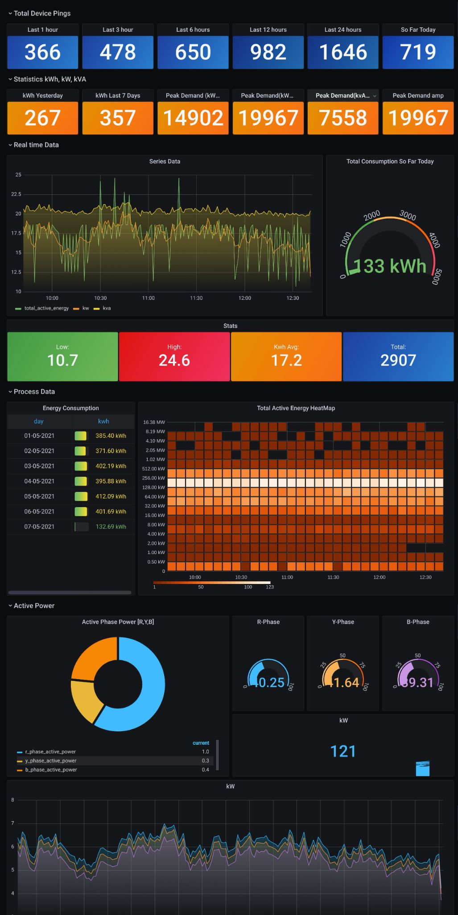


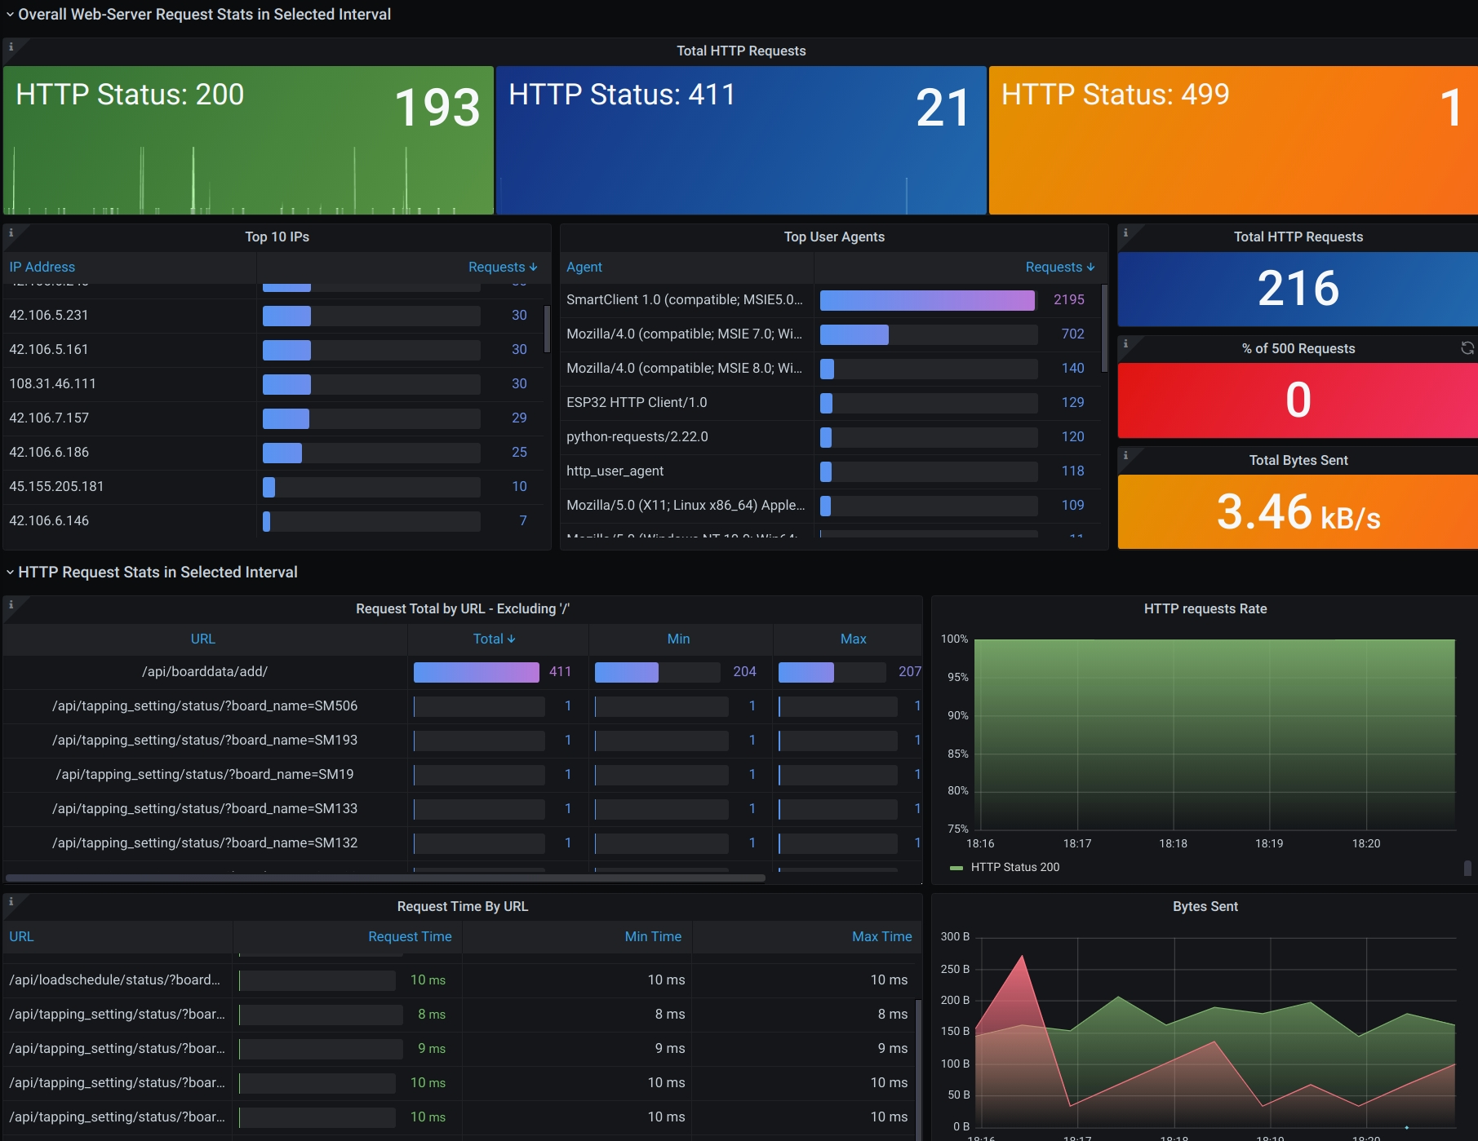
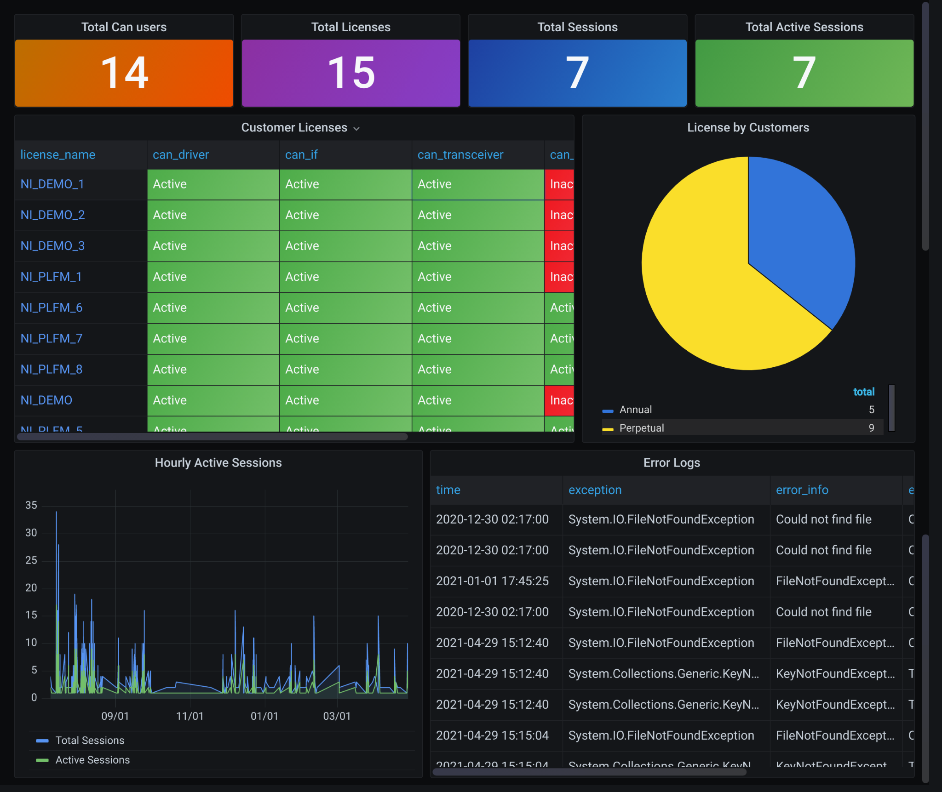
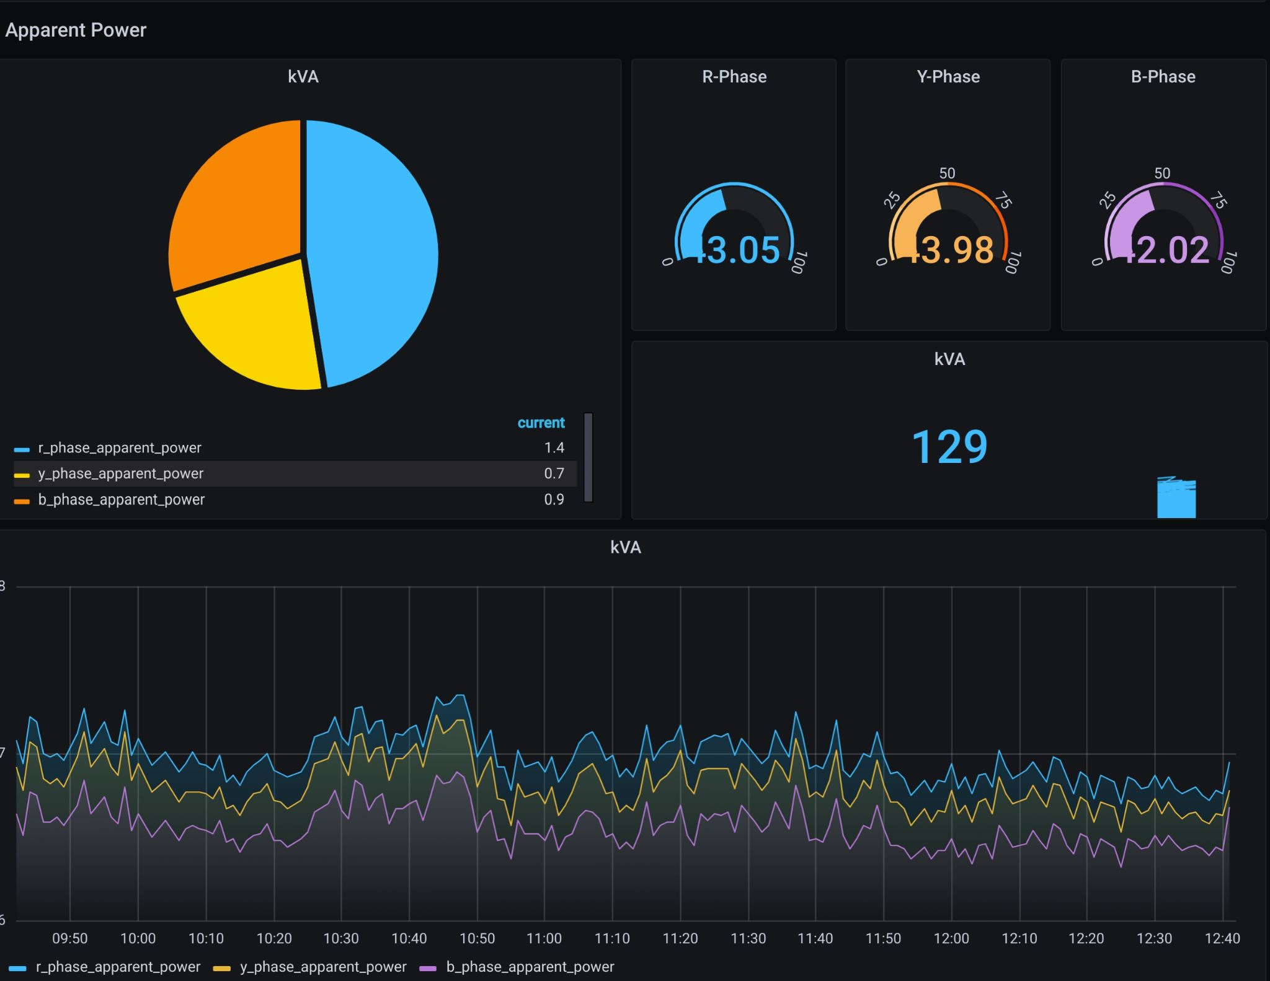
Centralized Log Aggregation & Analytics
With
oki & Grafana
by
ravin

Slide 2


Loki
Grafana
Solutions
Next Steps
What it is
How it Works
Benefits
What it is
How it Works
Benefits
Problems Faced
Resolutions
Use Cases
Why needed?
What to next?
Q&A

Slide 3
LOKI
It is a horizontally scalable, highly available, multi-tenant log aggregation system inspired by prometheus
Its Cost effective and easy to operate. Does not index contents of log
LogQL
{ job=”frontend”, env=”dev”} => {
time: “2020-01-23 15:56:01”.
line: “POST /api/prom/push HTTP 1.1 502 0”
}

Slide 4

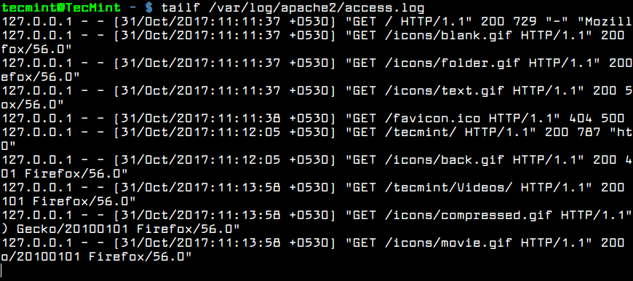
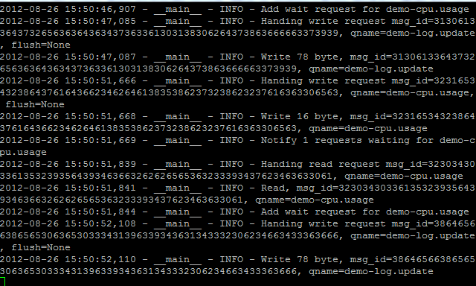
How it Works?
--- ---
------
Sys/App Logs
Application and system generated Logs

Slide 5
How it Works?
--- ---
server:
http_listen_port: 9080
clients:
- url: http://localhost:3100/loki/api/v1/push
scrape_configs:
- job_name: syslog
syslog:
json: false
max_age: 12h
static_configs:
- targets:
- localhost
labels:
job: syslog
host: localhost
__path__: /var/log/syslog
------
Sys/App Logs
Promtail
Application and system generated Logs
Ships Logs to Loki
Discover Targets
Attaches Labels
Pushes To Loki

Slide 6
How it Works?
--- ---
------
Sys/App Logs
Promtail
Loki Storage
Application and system generated Logs
Ships Logs to Loki
Discover Targets
Attaches Labels
Pushes To Loki
Log streams by ID & labels
Compressed chunks
Index Stores streams/labels linking to chunk

Slide 7
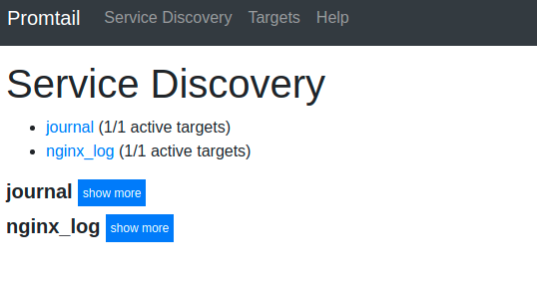
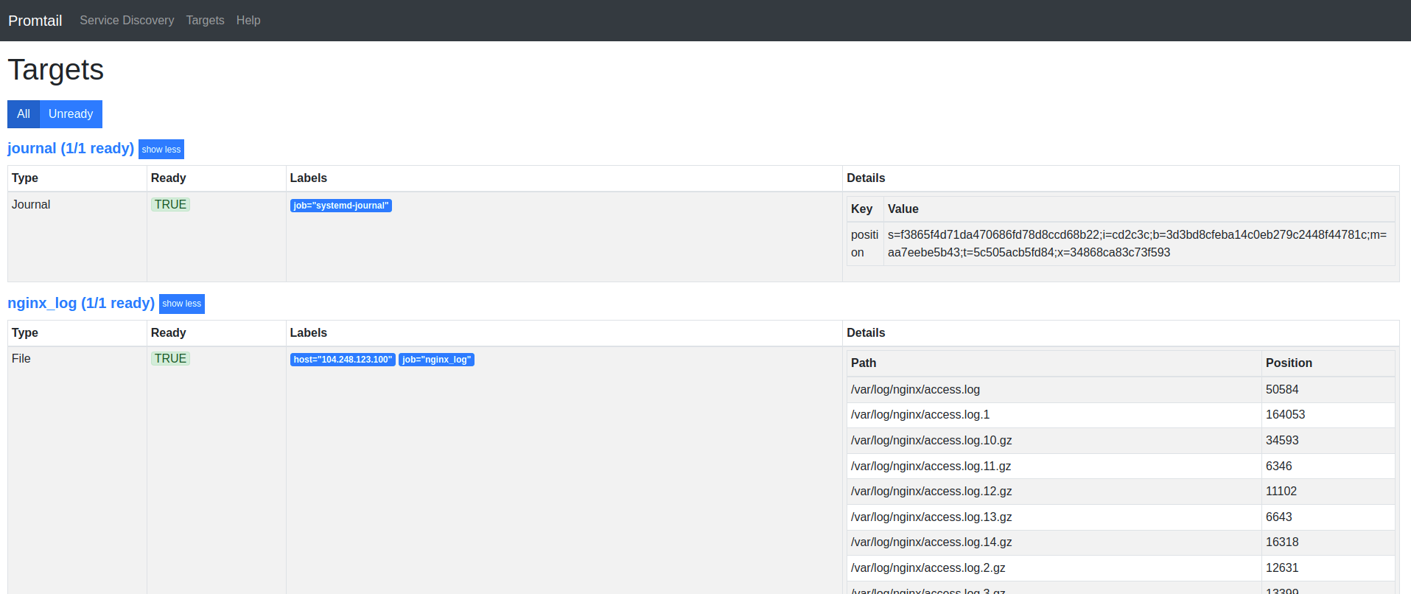
How it Works?

Slide 8
How it Works?
--- ---
------
Sys/App Logs
Promtail
Loki Storage
Visualization
Application and system generated Logs
Ships Logs to Loki
Discover Targets
Attaches Labels
Pushes To Loki
Log streams by ID & labels
Compressed chunks
Index Stores streams/labels linking to chunk
Create
Visualizations
Transform Data
Create and manage Alerts

Slide 9
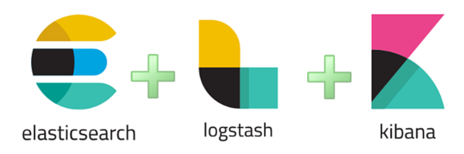
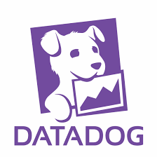





Benefits
Alternatives
REST API
Low Resource Footprint
Near Real Time Search
Perfect For K8s
Fast Data Ingestion
Why not SQL?
Promscale

Slide 10

Grafana
Open-source visualization and Analytics software
Query, Visualize, Alert On, Explore metrics - no matter where they are stored
In Beautiful English, it provides you tools to turn your Time-series Database into beautiful graphs and visualization
Export Metrics & Logs
Annotations
Dashboard Variables
VC Config
Manage Alerts
Import Dashboards & Plugins
Authentication &
Permissions
Provisioning

Slide 11
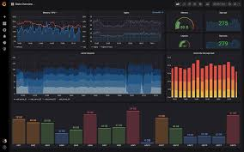




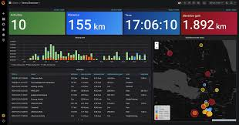




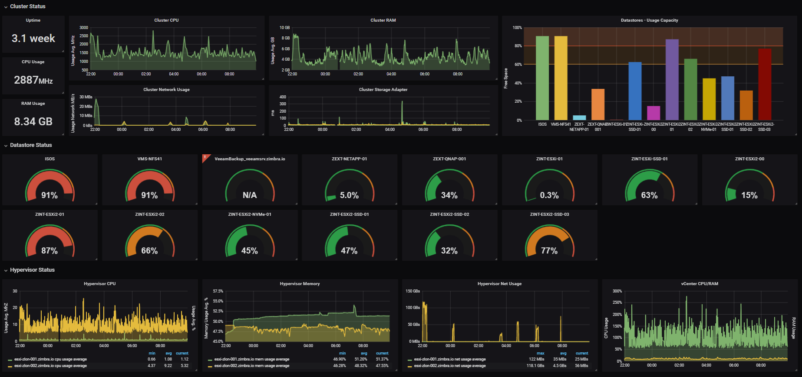

How it Works
Data Sources
API/Query
Dashboards/Alerts

Slide 12



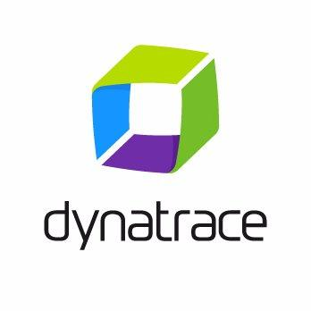

Benefits
Alternatives
Open-Source
On Demand Dynamic Dashboards from Data Sources
Customizable/interactive
Real-Time Monitoring & Alerts
Authentication & User Management
Plugins

Slide 13
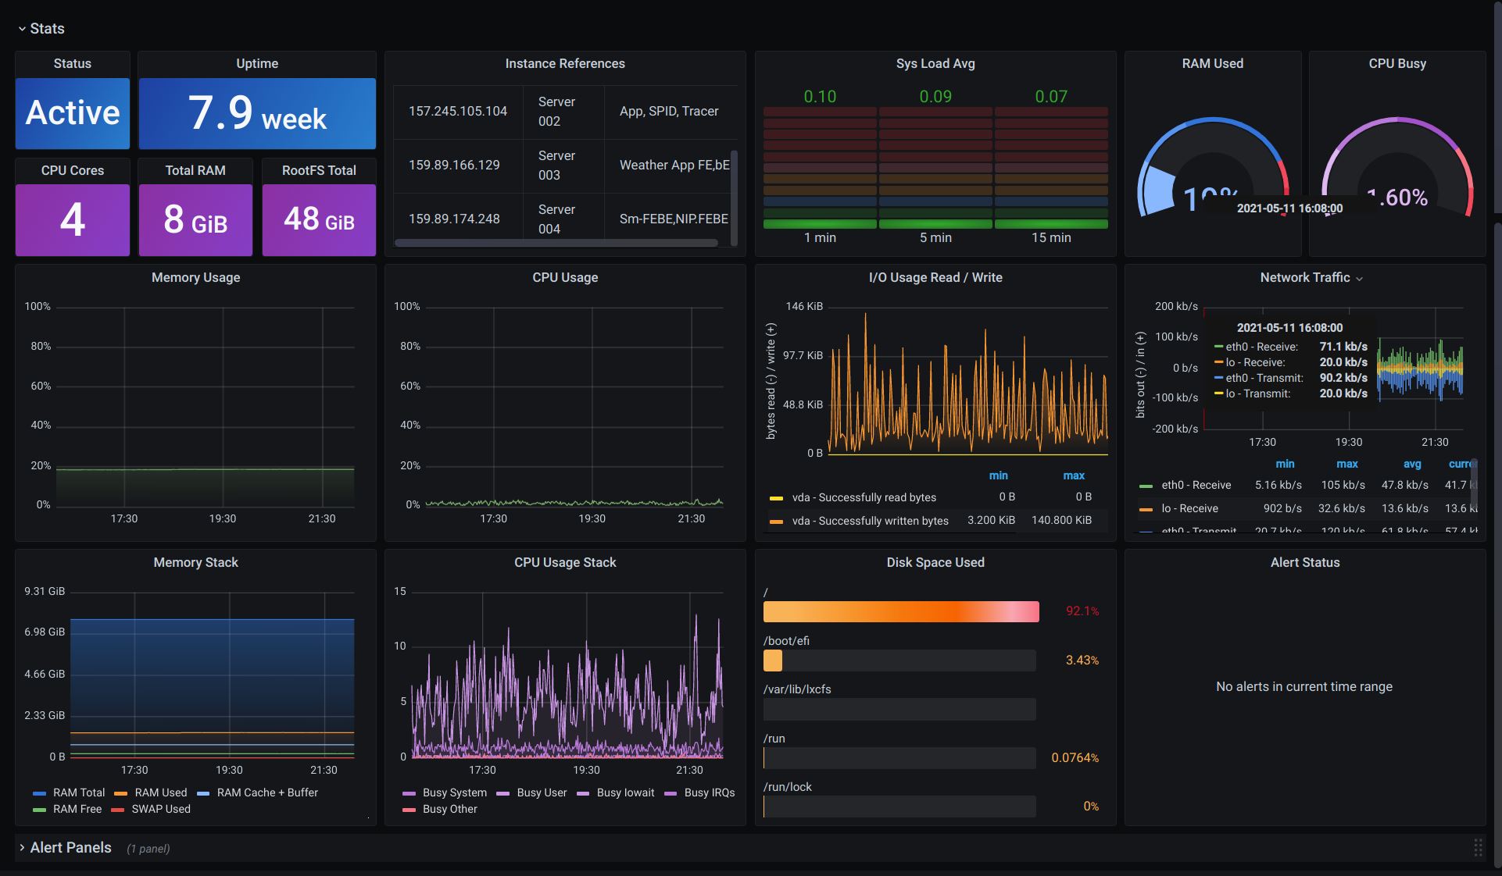
Problems Addressed & Resolved
Monitor Resource Usage
Centralized Control for monitoring events

Slide 14
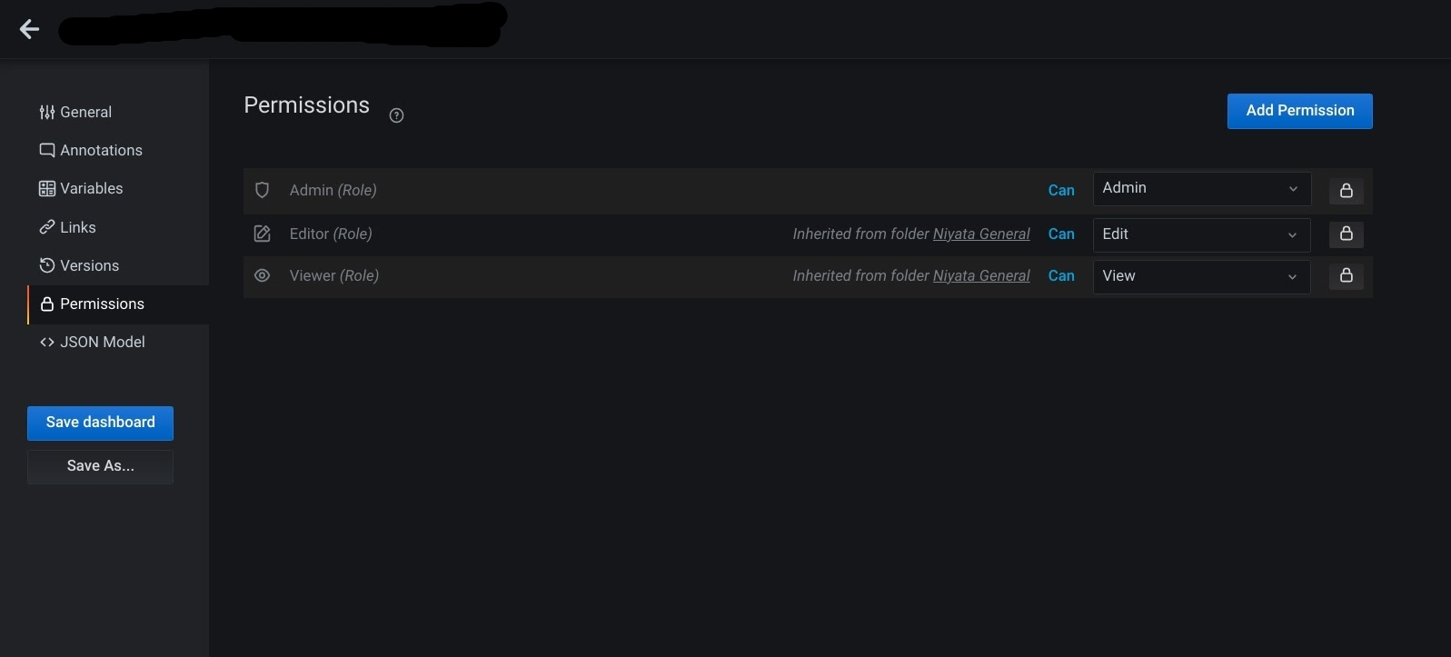
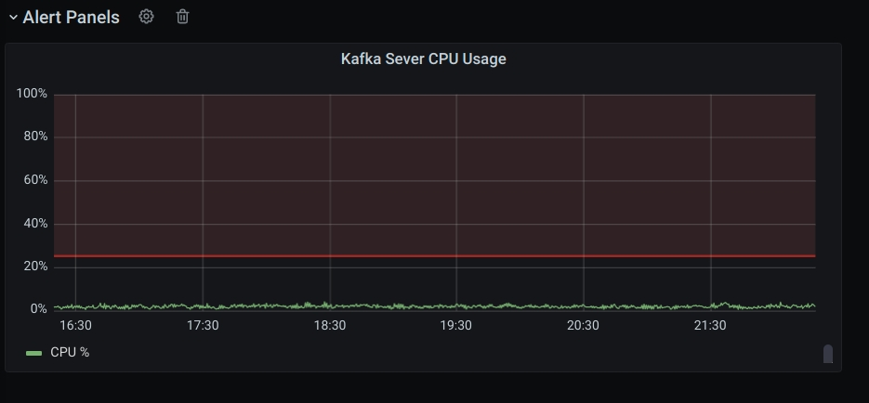
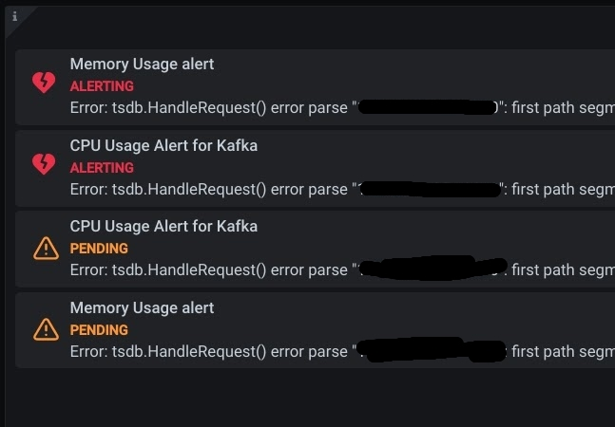
Problems Addressed & Resolved
Monitor Resource Usage
Centralized Control for monitoring events
Manage Permissions
Monitor Kafka and Alert

Slide 15
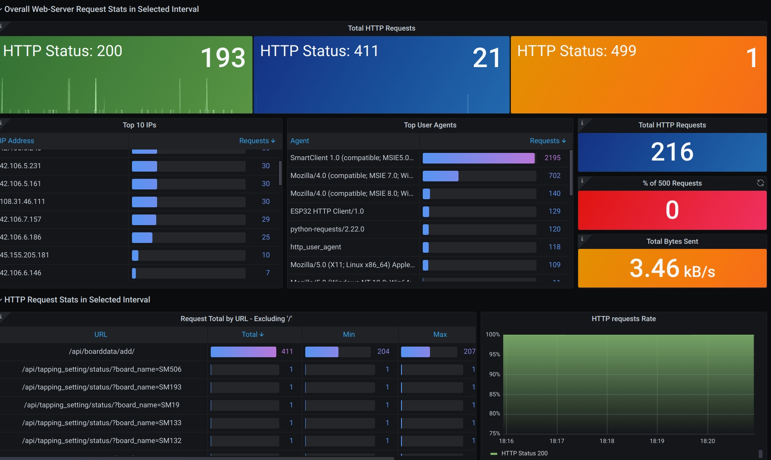
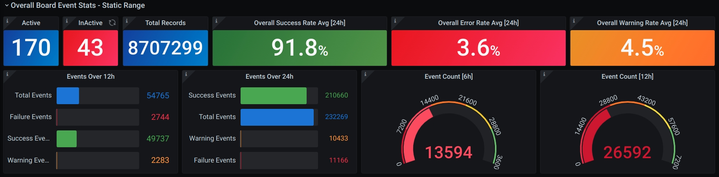
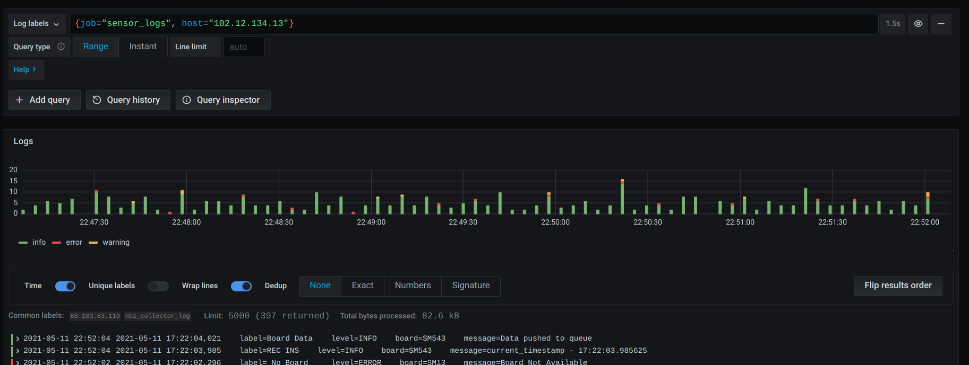
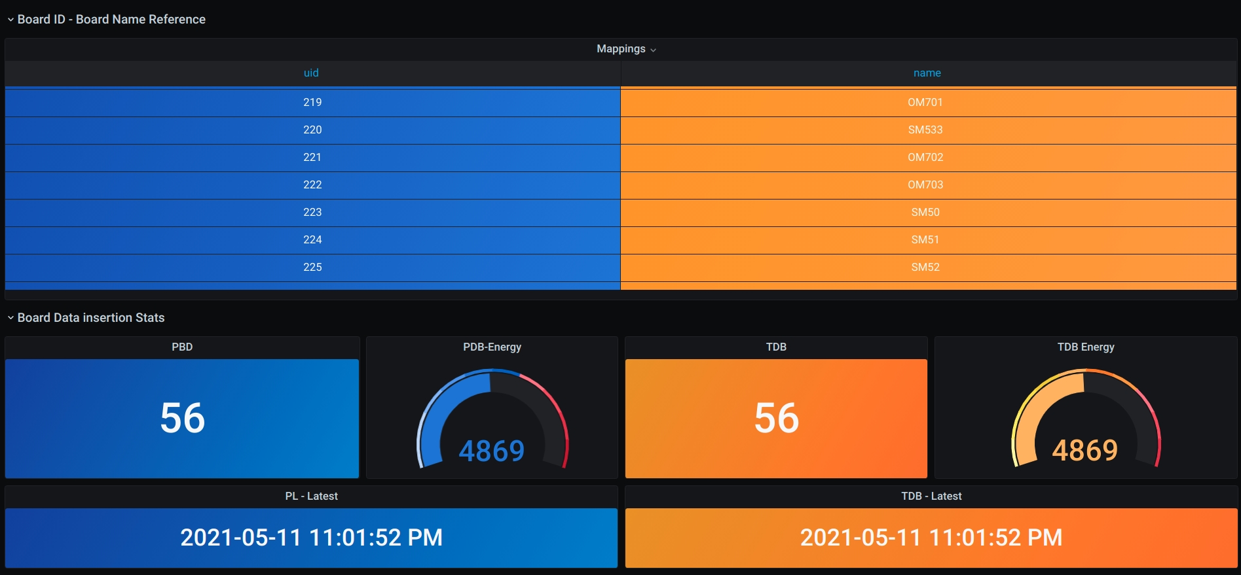
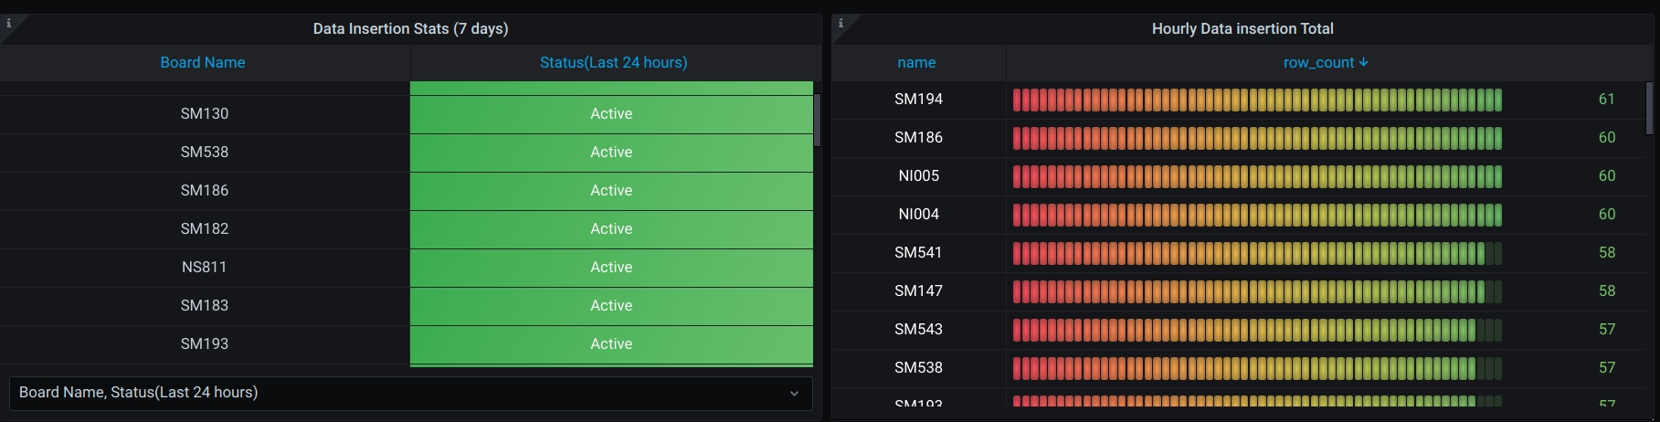
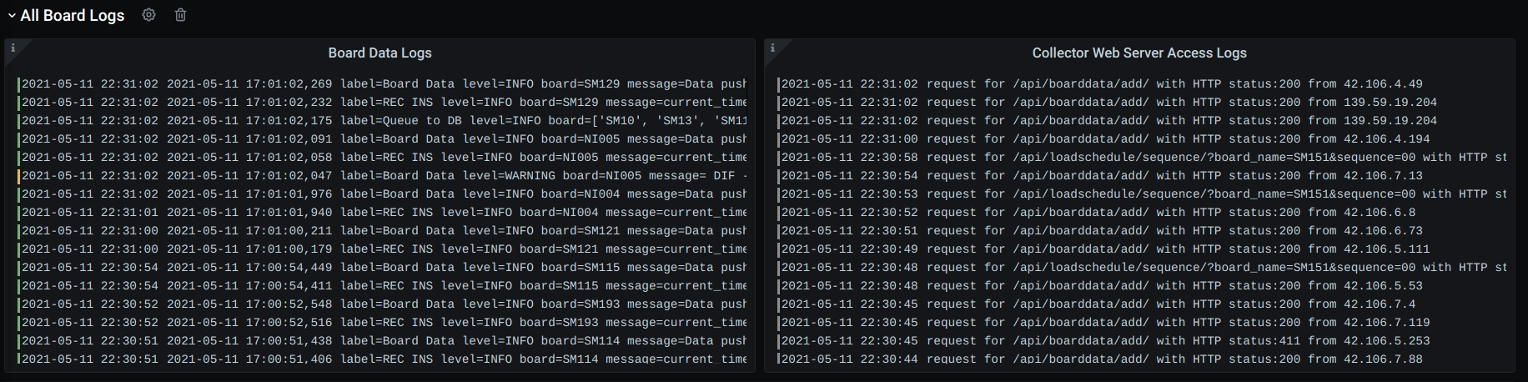
Problems Addressed & Resolved
Explore & Analyse logs
Data inserted into database
Correlate metrics
Source of errors
Resolve in minutes rather than hours/days

Slide 16
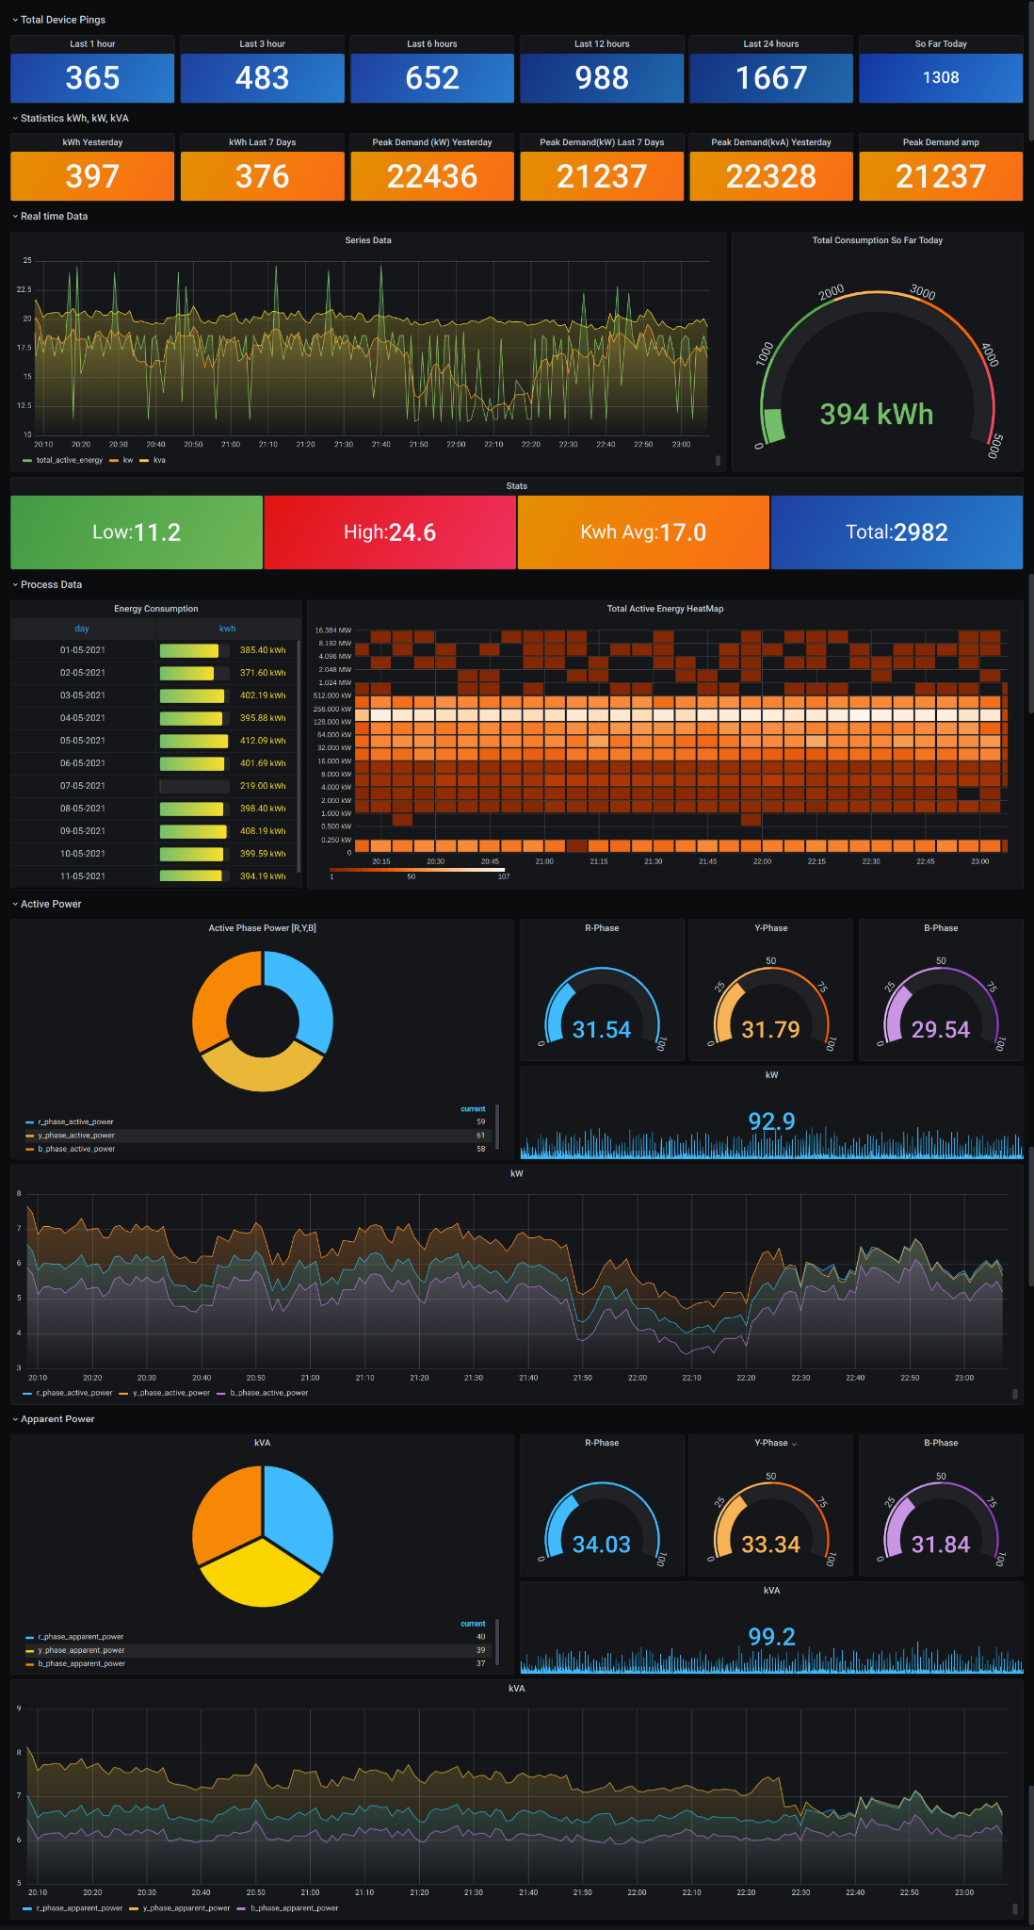
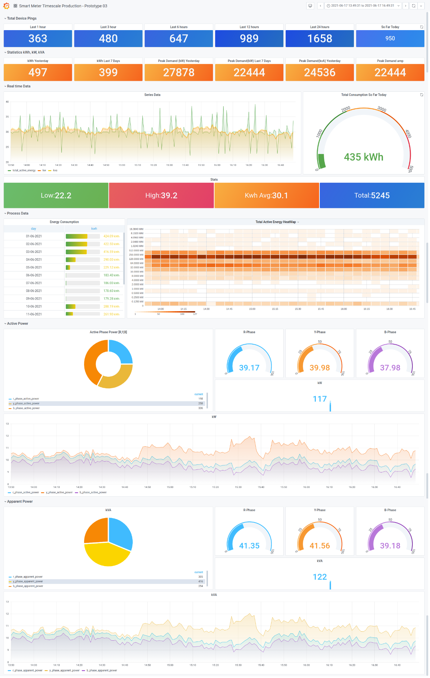
Didn’t stop us from exploring use cases
Mimic the live dashboard for IoT
Run a playlist of live dashboard in TV mode
Admin and Financial dashboards
Postgres, Redis and Nginx metrics

Slide 17
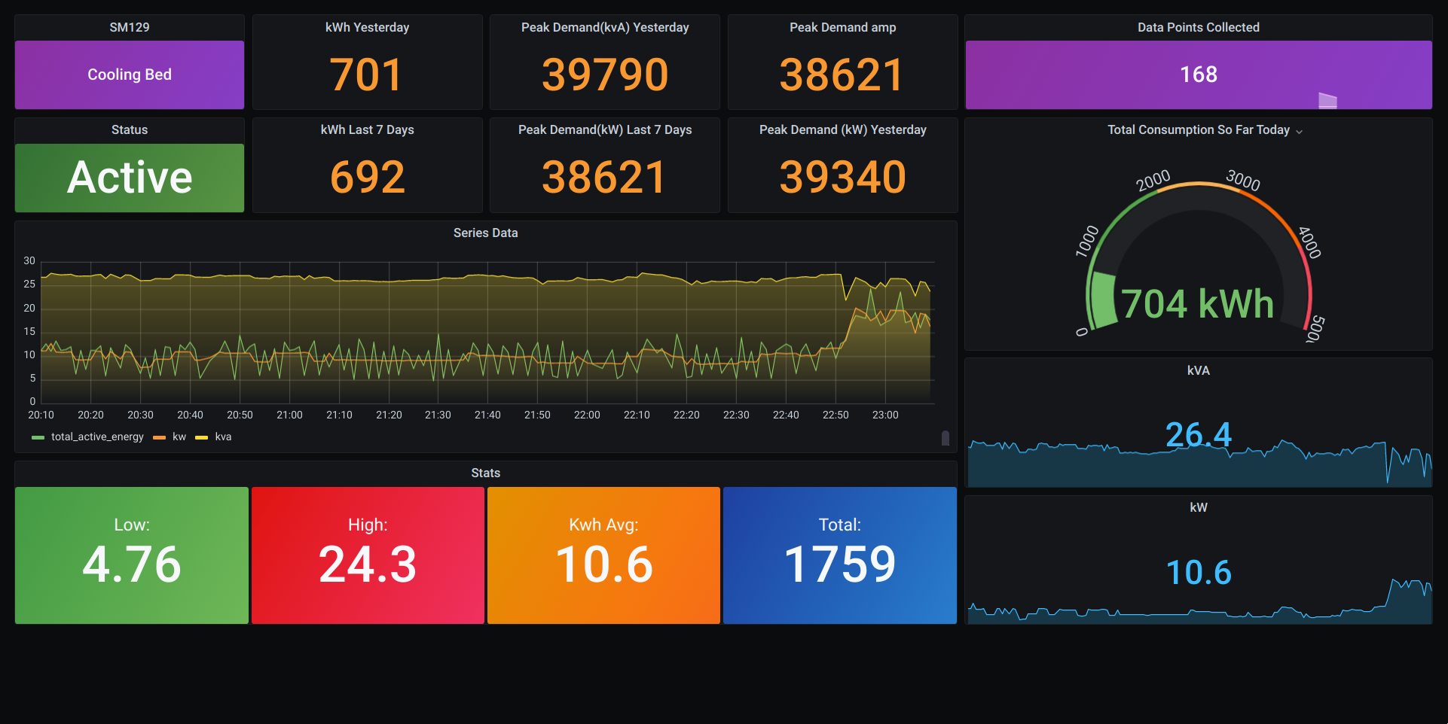
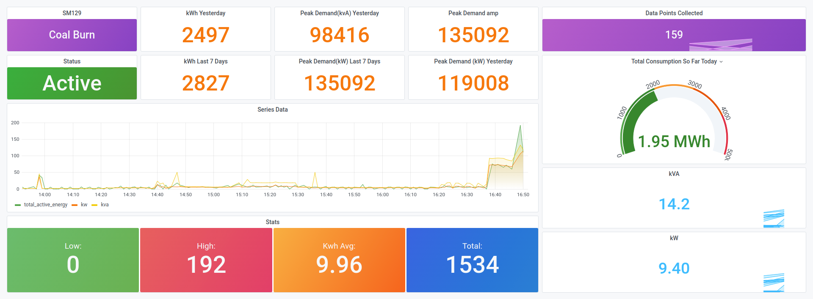
Didn’t stop us from exploring use cases
Mimic the live dashboard for IoT
Run a playlist of live dashboard in TV mode
Admin and Financial dashboards
Postgres, Redis and Nginx metrics

Slide 18
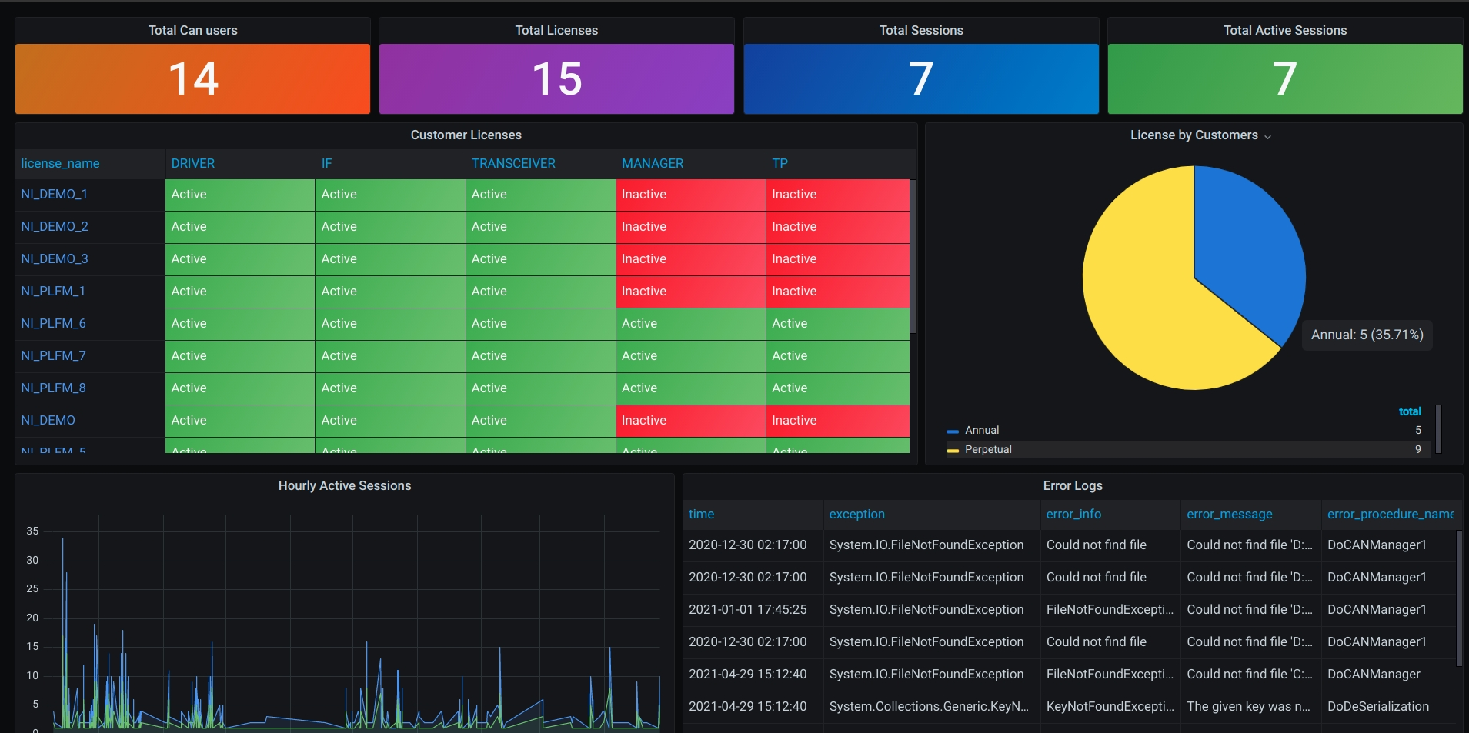
Didn’t stop us from exploring use cases
Mimic the live dashboard for IoT
Run a playlist of live dashboard in TV mode
Admin and Financial dashboards
Postgres, Redis and Nginx metrics

Slide 19
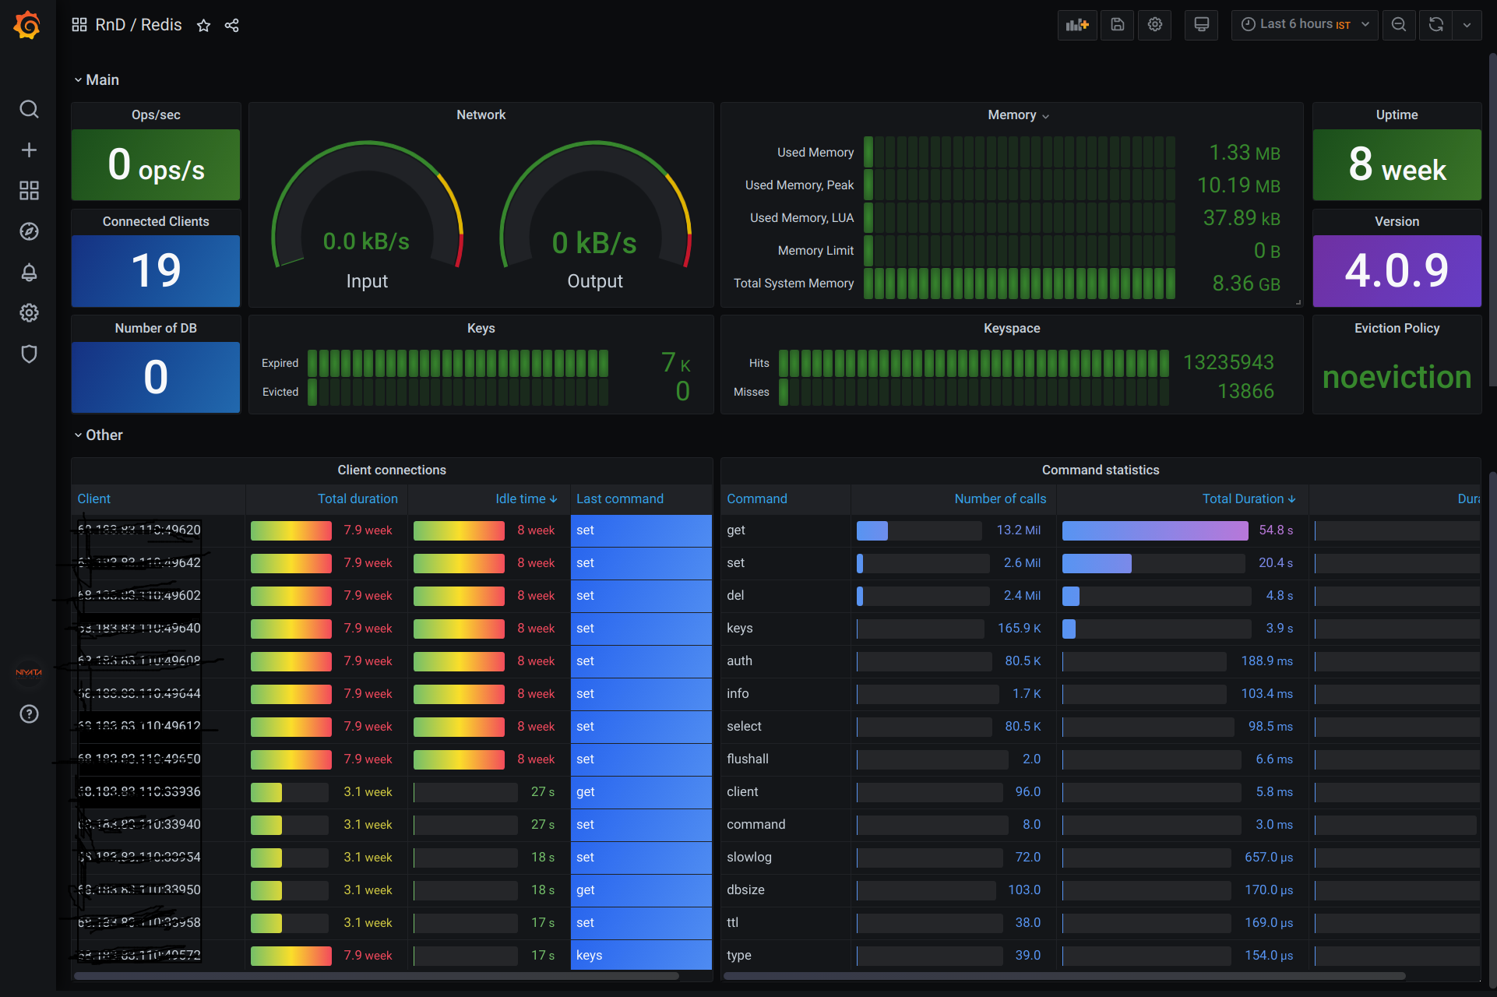
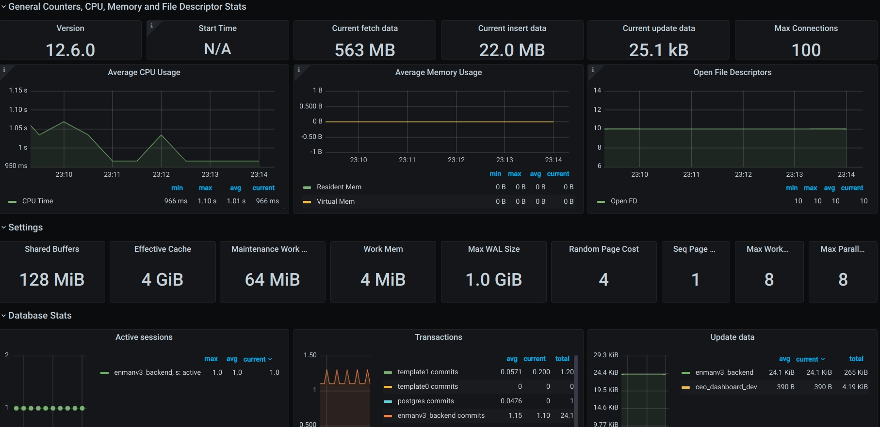
Didn’t stop us from exploring use cases
Mimic the live dashboard for IoT
Run a playlist of live dashboard in TV mode
Admin and Financial dashboards
Postgres, Redis and Nginx metrics

Slide 20

Why we need these?
Continuous Monitoring
Improved Quality
Faster Response
MTTR
Shift Left
Incident Management
Improved UX
You’ve Got Data
Analytics and Decision
Derive Business value
You can only improve something
when you can measure it
Faster MTTR by quickly narrowing down the issue
Centralized visualization of your system, logs and
application data
On demand Analytics Dashboards with the Power
of SQL and Grafana
Audit Trail ~ The Journey of data at your fingertips

Slide 21
Surrounded By data, ~Jay Baer Starved of Insights
Torture the data and it will confess to anything ~Ronal.H.Caose
No great marketing decisions have ever been made on qualitative data ~Ronal.H.Caose
A Tool to enhance intuition
We are entering a new world in which data may be more important than software ~Tim O’Reilly
With data collections, ‘the sooner the better’ is always the best answer ~Marissa Mayer
Information is the oil of 21st century and analytics is the combustion engine
~ Mr.Sondergaard
There were 5 exabytes if information created between dawn of civilization through 2003, but that much information is now created in every 2 days ~Eric Schmidt
Data beats emotions
~Sean Rad
Its capital mistake to theorize before one has data ~Conan Doyle
No matter where you are headed, your journey starts with great data
Every company has big data in its future and every company will eventually be in data business ~Thomas H
THANK YOU
The Goal is turn data into information and information into insight ~Carly Fiorina
Where there is data smoke, there is business fire ~ Thomas Redman
Above all else, show the data
And Don’t just show data Visualize It
Data are summaries of thousands of stories-tell a few of those stories to help make the data meaningful ~Dan Heath
You can have data without information, but you cannot have information without data ~Daniel Keys Moran
Don't just keep data Analyze It
No great marketing decisions have ever been made on qualitative data ~John Sculley
Don't just keep analysing Derive Insights
If we have data, let's look at data. If all we have are opinions, let's go with mine ~Jim Barksdate

